Slide 1

Sheema rohi Akuthota mounika madireddy mounika madishetty karan

Slide 2
Overview
Nosql database
Distributed nosql database
What is Riak?
History of Riak
Terminologies in Riak
Riak architecture
Crud operations

Slide 3
What is NoSQL database?
Originally refers to “non SQL or Not Only SQL”
useful for very large sets of distributed
data.

Slide 4
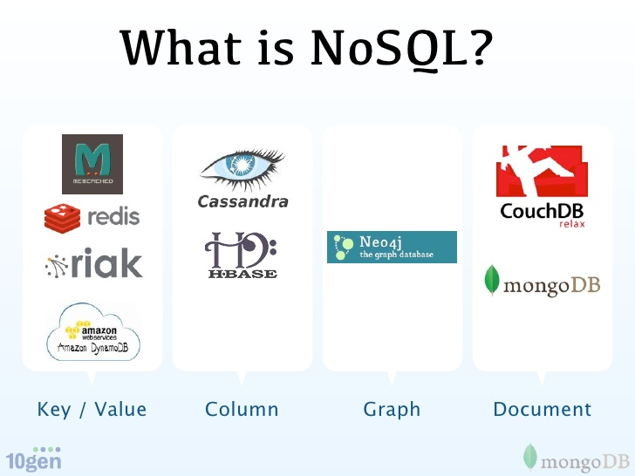

Slide 5
What is Distributed NoSql database?
Unstructured data is distributed among different nodes.
Processing of data is distributed among multiple servers.

Slide 6
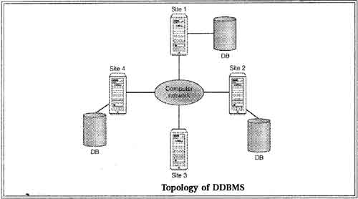
Distributed database

Slide 7
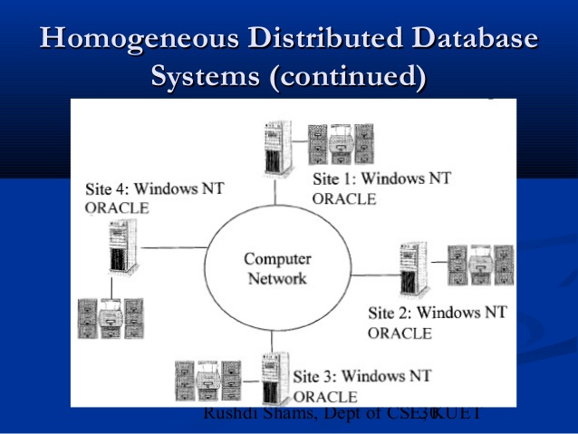
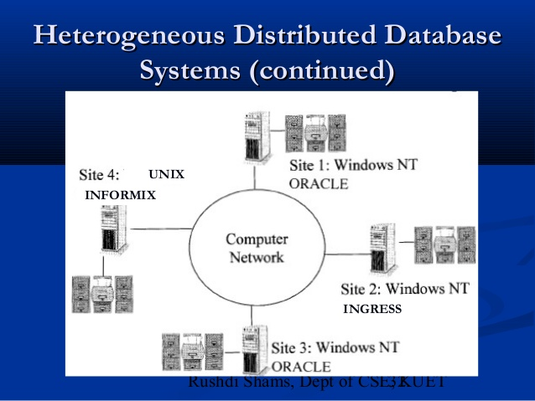
Homogenous
Heterogeneous

Slide 8
Database models:
Relational(ACID)
Document
Column
Graph
Key value (Riak)(BASE)-(basically available,soft state,eventually consistent)

Slide 9
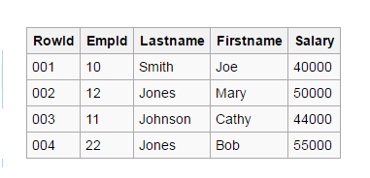
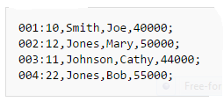
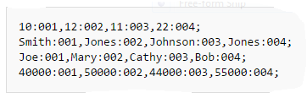
Table
Row store
Column store

Slide 10
Key value database benefits :
Flexible data modelling
High Performance
Massive scalability
High Availability
Operational Simplicity
Notes:
http://basho.com/resources/key-value-databases/
Key value database benefits :

Slide 11
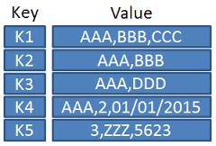
Key value pair:
No query language.
Read ,write,delete and update data with ease.

Slide 12
What is Riak?
Written by Andy Gross and others in Basho technologies.
Released on feb 21st,2012.
Written in Earlang.
Recent version is 2.1, released on apr 16,2015.
Open Source, Distributed Key-value database.
It was built as a solution to real bigdata problems.

Slide 13
Riak is inspired by:
Amazons dynamo
CAP theorem

Slide 14
What is the language it is implemented in ?
Erlang
Developed by Joe Armstrong, Robert Virding and Mike Williams in 1986.
Released as open source in 1998.

Slide 15
Why we use erlang?
Battle proven
Saves time and Money
Easy to learn

Slide 16
Why erlang was choosing for developing most of the databases?
Hot code replacement
Transparent distribution
Fault tolerance
Solid Distributed Communication
Notes:
Whyerlang.com

Slide 17
Erlang used by??
Amazon
Facebook
WhatsApp
Couch dB(projects)

Slide 18
Schema design for riak :
What you loose?
Tables
Foreign keys and constraints
ACID
Sophisticated query language(sql)

Slide 19
What you gain?
More flexible, fluid designs
More natural data representations
Scaling without pain
Reduced operational complexity

Slide 20
Replication strategies:
Distributing data across several servers , thereby improving availability and capacity.
Riak combines both replication and partitioning.

Slide 21
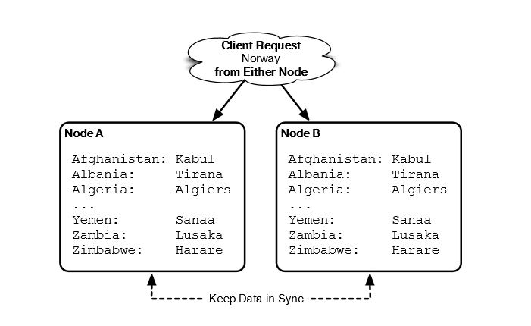
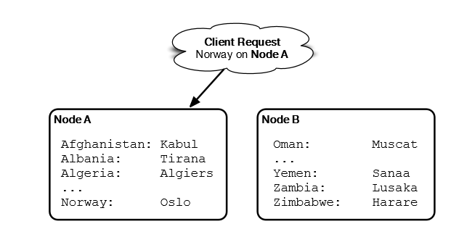
Difference
Replication
Partition

Slide 22
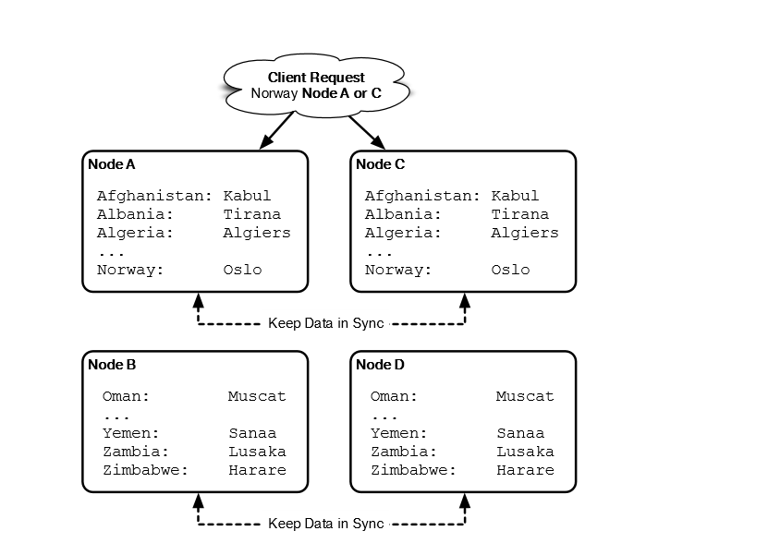
Riak with replication and partition

Slide 23
Terminology
Key value
Buckets
The ring
Nodes
Vector clock
N/R/W
Quorum
Entropy

Slide 24
Key-value :
Most basic structure in riak construct.
Suppose key is like home address such as bob’s house with the unique key 5124,while the value would be maybe Bob.
Retrieving bob is done by:
bob =hash table[“5124”]

Slide 25
Buckets:
Address in some town are more than a house number , but also a street, there could be another 5124 on another street so unique address is combining both.
Buckets are like streets in riak:
Main[“5122”] = “alice”
Bagshot[“5122”]=“goutham”

Slide 26
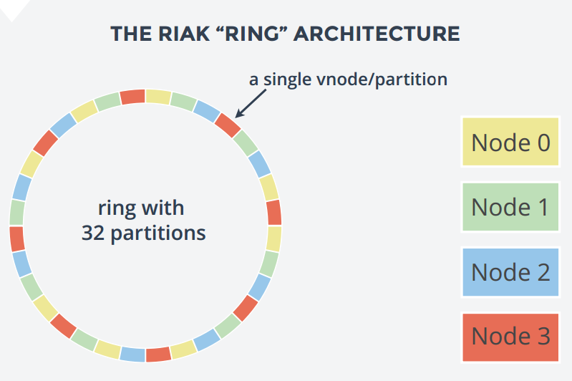
Riak ring:

Slide 27
N/R/W :
Riak allows you to choose n/r/w value.
N – number of nodes you want to replicate data.
R- number of nodes read from before returning value to user.
W- number of nodes written to before considered success.

Slide 28
Vector clock:
When there is case of R= all , we can compare all nodes and choose the latest one .
But how to know the latest value?
There comes vector clocks.
Vector clocks measure a sequence of events, just like normal clock.
They keep track of how, who, modifies an object.

Slide 29
Quorum:
It is one more than half of all the total replicated nodes (floor(N/2) + 1).
Important because, since more than half of all nodes are written to and more tan half are read from, they we get the most recent value.

Slide 30
Entropy:
It is a byproduct of eventual consistency.
Eventual consistency says a write will replicate to other nodes in time, there may be a bit delay during which all nodes do not contain the same value.
In such cases it follows policies such as:
Last write wins
Read repair

Slide 31
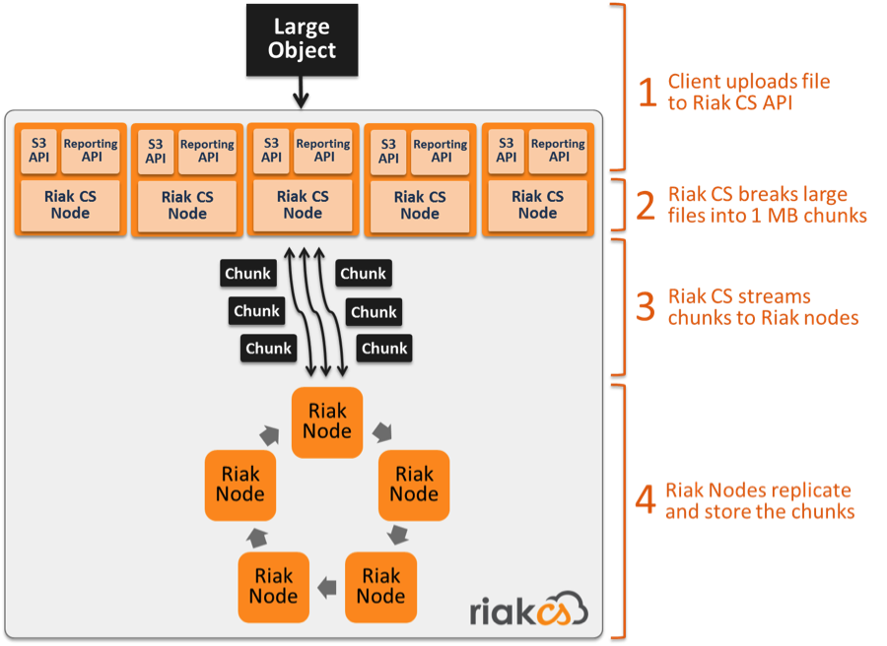
Network Architecture

Slide 32
Do distributed databases worry about sharding or partitioning ??
No..!!!
Sharding and partitioning in DDB is done automatically.
Notes:
www.quora.com/whats-the-difference-between-sharding-DB-tables -and -partitioning-them

Slide 33
Benefits of riak:
Scalability
Availability
Fault Tolerance
performance

Slide 34
Tuning for consistency
Follows CAP theorem -- C (consistent), A (available), P (partition-tolerant) system.
Riak focuses on the AP of CAP by default
Riak is highly available to serve requests, with the ability to tune its level of consistency or availabilty.

Slide 35
Riak’s Math
N = The # of Replicas
R = # of replicas needed for successful read
W = # of replicas needed for successful write
N-R = Read Fault tolerance
N-W = Write Fault tolerance
N = 4,W = 2, R = 1
N-R=2 hosts can be down Riak still performs writes
N-W=3 hosts can be down Riak still performs reads

Slide 36
Here it is a requirement that upon update operations all nodes agree on the new value before making the new value visible to clients.
Strong consistency
Eventual consistency
If data is getting updated in two nodes ,after getting updates both nodes will communicate and finally a conflict can occur and it can be solved by policy like(last-write-wins)before it is shown to clients.
Notes:
Docs.basho.com/riak/kv/2.1.4/learn/concepts/eventual-consistency/
Docs.basho.com/riak/kv/2.1.4/learn/concepts/strong-consistency/

Slide 37
Riak management advantages:
adding/removing nodes.
supports multiple backends .
Notes:
Searchcloudcomputing.techtarget.com/definition/sharding

Slide 38
Supported languages :
Riak has official drivers for the following languages:
Erlang
Java
PHP
Python
Ruby

Slide 39
Riak operations:
Since it is a KV database most basic commands are setting and getting values or eventual deleting them.
The basic structure for riak operation is:
PUT /riak/bucket/key
GET /riak/bucket/key
DELETE /riak/bucket/key

Slide 40
Lists:
curl 'http://localhost:8098/riak/food?keys=true' { ... "keys": [ "favorite" ] }
And this will give us all of our keys under the food bucket.
curl 'http://localhost:8098/riak/food?keys=true' { ... "keys": [ "favorite" ] }
curl 'http://localhost:8098/riak/food?keys=true' { ... "keys": [ "favorite" ] }
Riak provides two kinds of lists.
1.List all buckets in your cluster .
The following will give us all of our buckets as a JSON object.
curl 'http://localhost:8098/riak?buckets=true'
2. List all keys under a specific bucket.
And this will give us all of our keys under the food bucket.
curl 'http://localhost:8098/riak/food?keys=true' { ... "keys": [ "favorite" ] }
Notes:
And this will give us all of our keys under the food bucket.

Slide 41
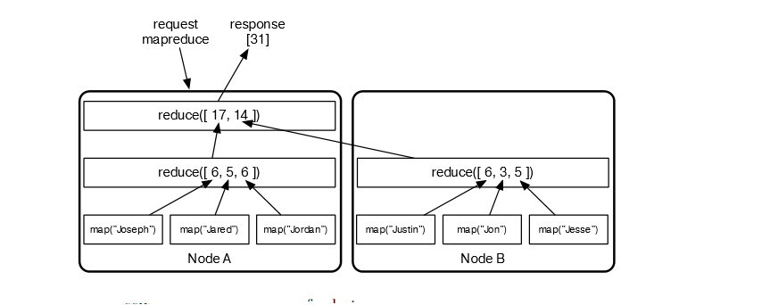
Map reduce
Useful for filtering by tags, counting nodes, extracting links.
Aggregates large amounts of data.

Slide 42
Riak is awesome because:
 | Cassandra | Couch Db | Riak
COOL? | YES | YES | YES
DISTRIBUTED | YES |  | YES
HTTP/REST |  | YES | YES
JSON |  | YES | YES
ERLANG |  | YES | YES
M/R |  | YES | YES
Notes:
VIME0.COM/7318171

Slide 43






Riak in real world

Slide 44
Demo:
Curl operations :
Put:
Get :
curl -XPUT 'http://cs2.mwsu.edu:8098/riak/mysubject/intresting' \
-H 'Content-Type:text/plain' \
-d ‘dbms'
curl -XGET 'http://cs2.mwsu.edu:8098/riak/subject/favorite'

Slide 45
Demo
Post
Delete
curl -i -XPOST 'http://cs2.mwsu.edu:8098/riak/people' \
-H 'Content-Type:application/json' \
-d '{"name":"aaron"}'
curl -XDELETE 'http://cs2.mwswu.edu:8098/riak/people/DNQGJY0KtcHMirkidasA066yj5V'

Slide 46
LIST OF KEYS:
Inserting json data to riak:
Curl 'http://cs2.mwsu.edu:8098/riak?buckets=true’
curl -v 'http://cs2.mwsu.edu:8098/riak/food?list=stream'
curl -v -X PUT http://cs2.mwsu.edu:8098/riak/news/news1 -H "Content-Type: application/json" -d '{"title”:”Myexperience with masters","author”:"Mounika","text”:"Mytextbook”}'

Slide 47
listing all keys in a bucket:
put:(storing without a key)
curl -i http://cs2.mwsu.edu:8098/buckets/food/keys?keys=true
curl -i http://cs2.mwsu.edu:8098/buckets/subject/keys?keys=true
curl -v http://cs2.mwsu.edu:8098/buckets/test/keys \
-H "Content-Type: text/plain" -d 'this is a test’

Slide 48
put:(storing with a key value)
curl -v -XPUT -d '{"bar":"baz"}' -H "Content-Type: application/json" -H "X-Riak-Vclock: a85hYGBgzGDKBVIszMk55zKYEhnzWBlKIniO8mUBAA==" http://cs2.mwsu.edu:8098/buckets/test/keys/doc?returnbody=true

Slide 49
Put :
curl -XPUT 'http://cs2.mwsu.edu:8098/riak/mysubject/intresting' \
-H 'Content-Type:text/plain' \
-d ‘dbms'

